Slide 1
Intro to Pair Programming and
Test-Driven Development

Slide 2
Pair Programming Roles
Driver
Navigator
Takes control of the keyboard
Constantly reviews what is being typed
Regular switching

Slide 3
Expected Benefits
Continuous Code Reviews. Many mistakes get caught as they are being typed in rather than in QA test or in the field, leading to lower end defect count
Pair Relaying. The designs are better and code length shorter
Line-of-sight learning. The people learn significantly more about the system and about software development

Slide 4
Expected Benefits
Shared Understanding. The project ends up with multiple people understanding each piece of the system
Improved Collaboration. The people learn to work together and talk more often together, giving better information flow and team dynamics
More enjoyment

Slide 5
Core Pairing Guidelines
1. Collaborate; don't critique
2. Actively contribute
3. Switch roles frequently
4. Find comfortable work stations
5. Rest if you must.

Slide 6
Pairing Smells
1. Unequal access, e.g., one person dominates the keyboard
2. Unhealthy relationship
3. Worker-rester relationship

Slide 7
Pairing Smells
4. Endless debate
5. "Go make me a cup of tea" syndrome

Slide 8
When is pair programming least effective?
1. When working on non-complex mechanical-like tasks
2. When both parties do not have the same level of expertise (is this really bad?) - great for training but pairs are more engaged when they have the same level of expertise
3. When pairs don't rotate

Slide 9
Pair Programming and Test-Driven Development (TDD)
Can these 2 go together?

Slide 10
The TDD Mantra
RED
Write a test first. See it fail
GREEN
GREEN
Write the bare minimum code to make the test pass
REFACTOR

Slide 11
TDD + Pair Programming
(Ping Pong Method)
1
Write a failing test
2
Make the test pass.
Write a new test
3
Make the new test pass.
Write a new test or refactor

Slide 12
Refactoring
Key Principle:
Don't Repeat Yourself

Slide 13
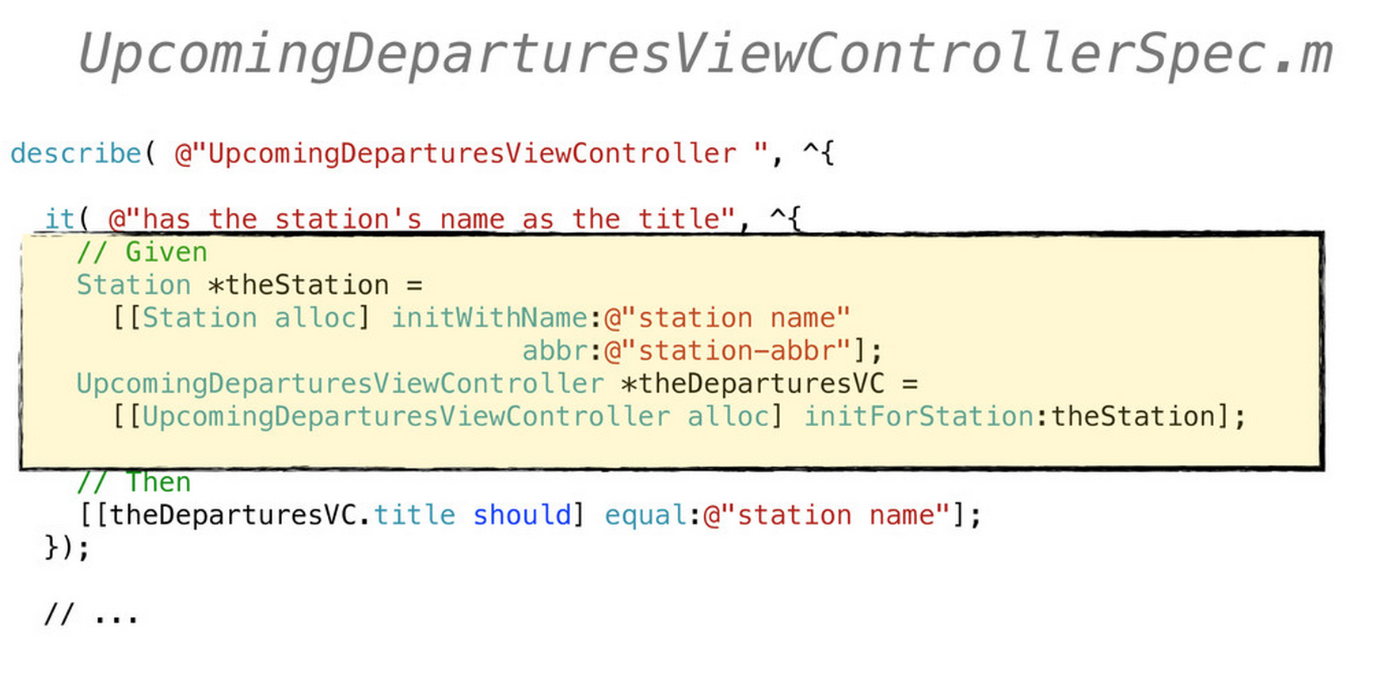
Refactoring

Slide 14
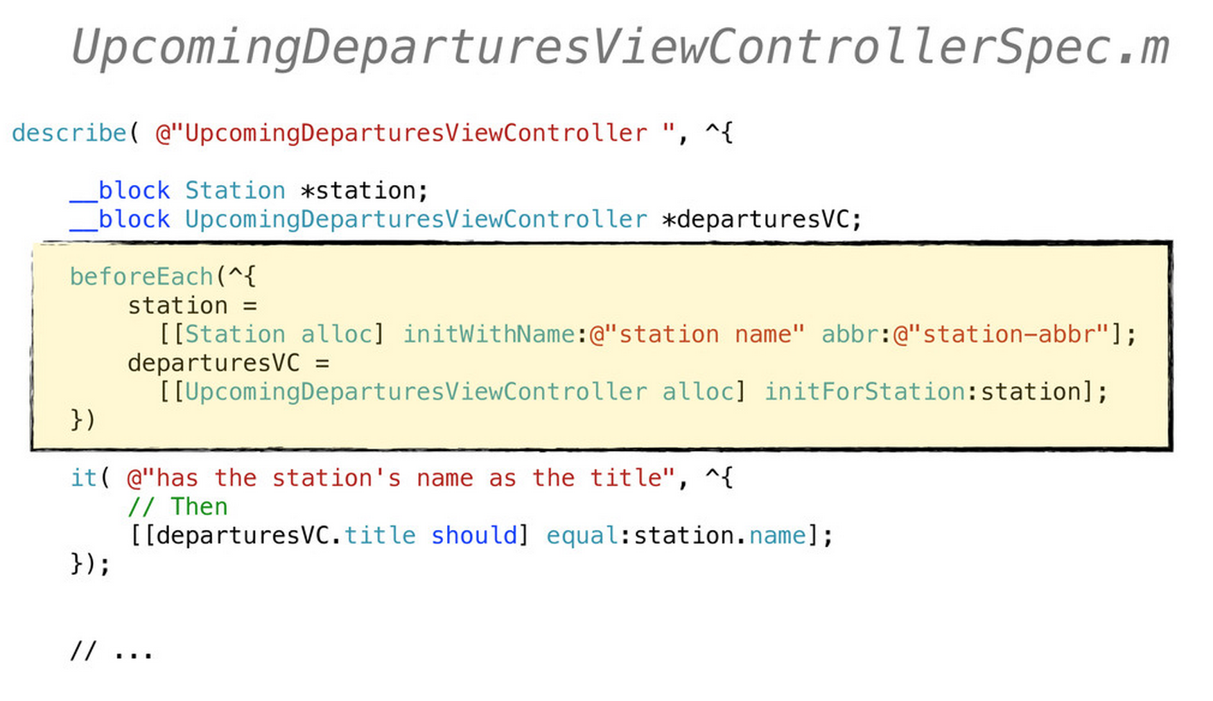
Refactoring

Slide 15
Choose a template
Android
bit.ly/CodingDojoAndroidKata
IOS
bit.ly/CodingDojoIOSKata
C# .NET
bit.ly/CodingDojoDotNetKata

